Slide 1

Personal Image Classifier
Lesson 3

Slide 2
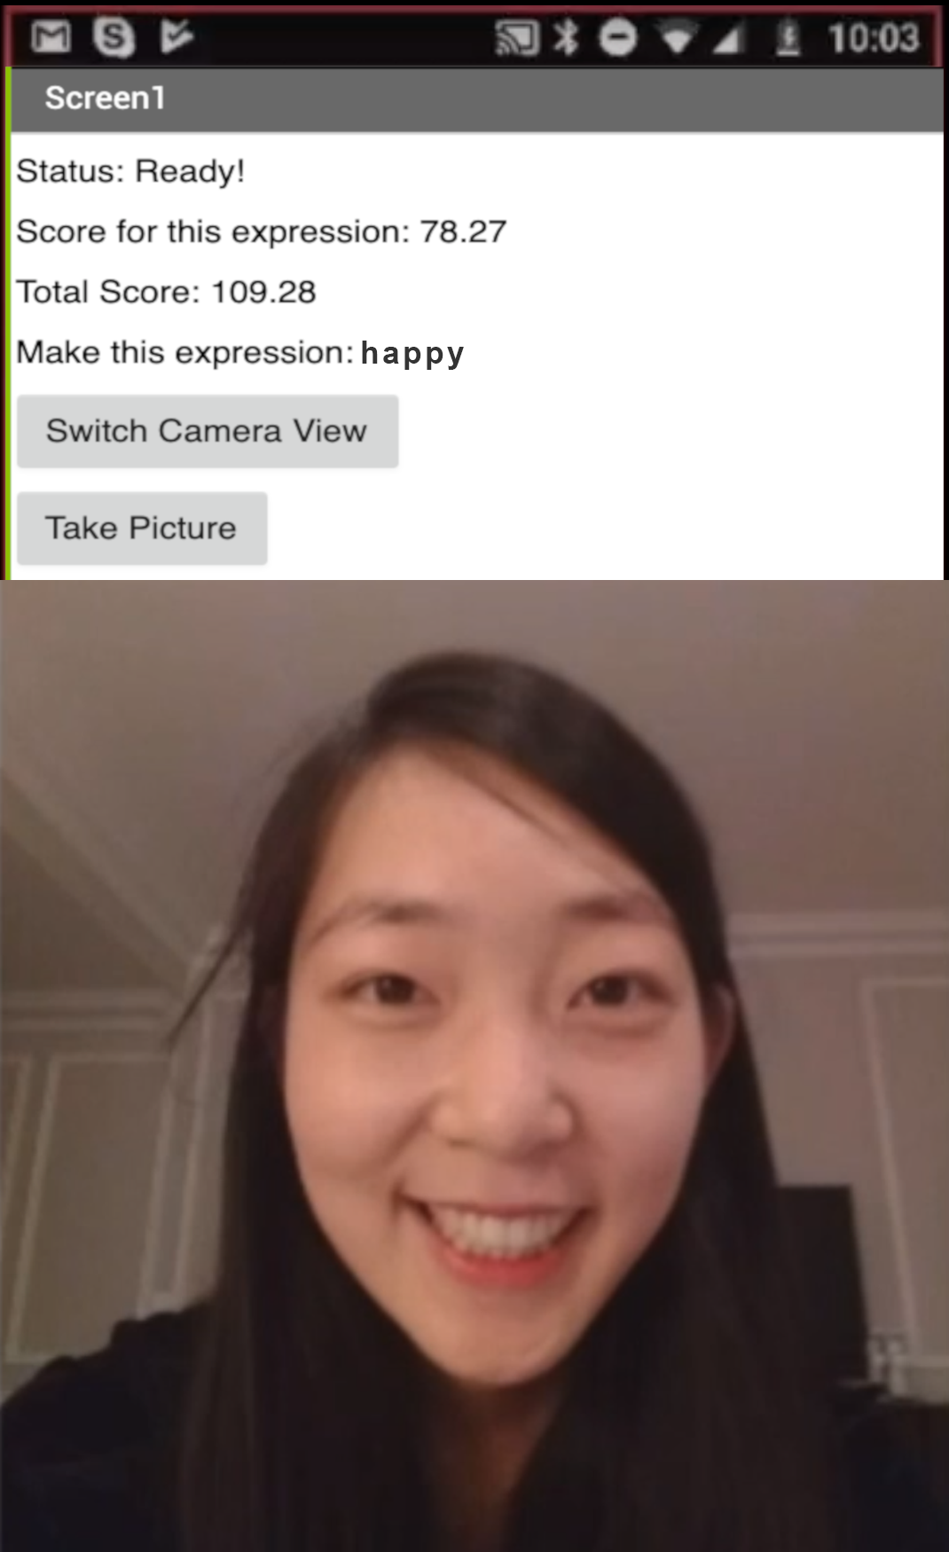
Expression Match App
You will use the model you trained in Lesson 1 in a new game app
You will build the entire app in App Inventor
User tries to match each label (facial expression)
User gains points based on the confidence level for the label

Slide 3
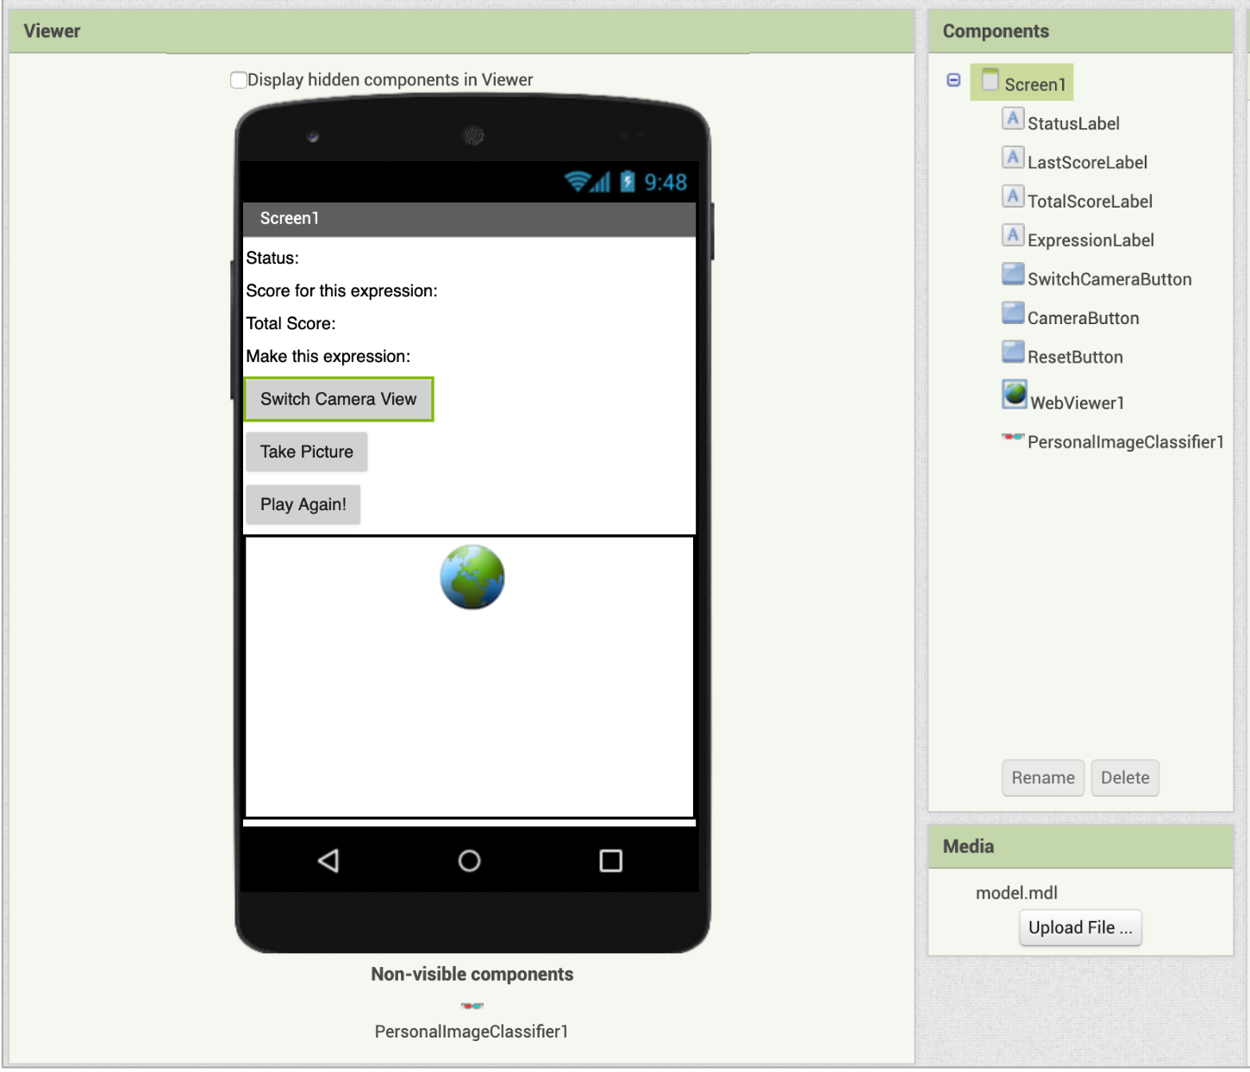
Designer

